Slide 1
Music & Memory℠ Will Work in Rural Areas, Too!
Linn Community Nursing Home
Janell Wohler
Administrator
Martha Hornbostel
Music & Memory℠ Coordinator

Slide 2
NEBRASKA
MISSOURI
COLORADO
How Rural Are We?
It’s 33 miles to the nearest Walmart
It’s 77 miles to the nearest VoTech
It’s 40 miles to the nearest 2 year college
It’s 60 miles to the nearest 4 year college
OKLAHOMA

Slide 3
Who We Are
Built in 1970
501(c)3 non-profit
Founded by community leaders and local churches
60 beds, 70 employees
No major donors, no auxiliary

Slide 4
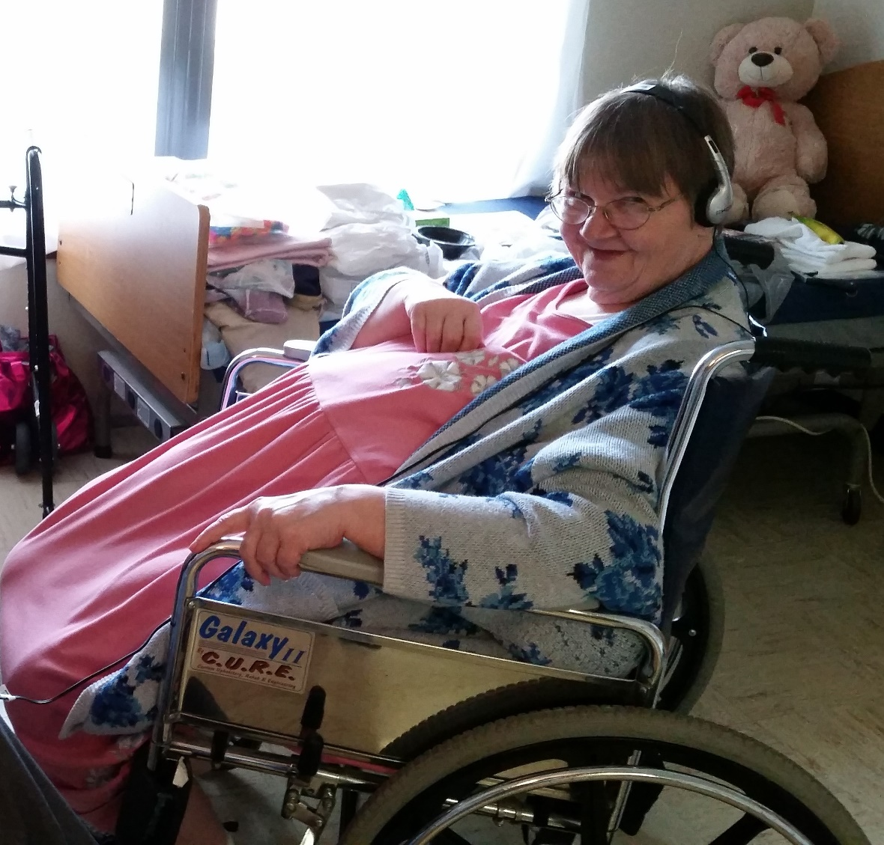
What We Do
Person-directed care
Culture-change
Educate Others
CNA and CMA Classes
Dietary Manager is a certified ServeSafe Instructor
“Listen & Learn” Series with topics to educate the community about issues facing aging
Currently at ZERO% use of antipsychotics
Great Plains Quality Care Collaborative
PEAK Member

Slide 5
How we started
We had Admin and staff buy-in
We had a music volunteer who wanted to be part of the program and someone to be with every elder when they experienced their “aha!” moment – Me!
We had a champion – a man who loves his wife with Alzheimer’s, loves our home, and believes in Music & Memory℠ and tells everyone he knows about all three. A brief mention by him in a newspaper interview touched off all our media attention
I looked to the High School for manpower

Slide 6
What We Expected
A control group of 5-7 elders
5-7 high school volunteers
A $400 fundraiser (done by the FCCLA)
Train staff to use the Music & Memory℠
Turn control group over to staff
Evaluate, and move to another control group of 4-7 elders

Slide 7
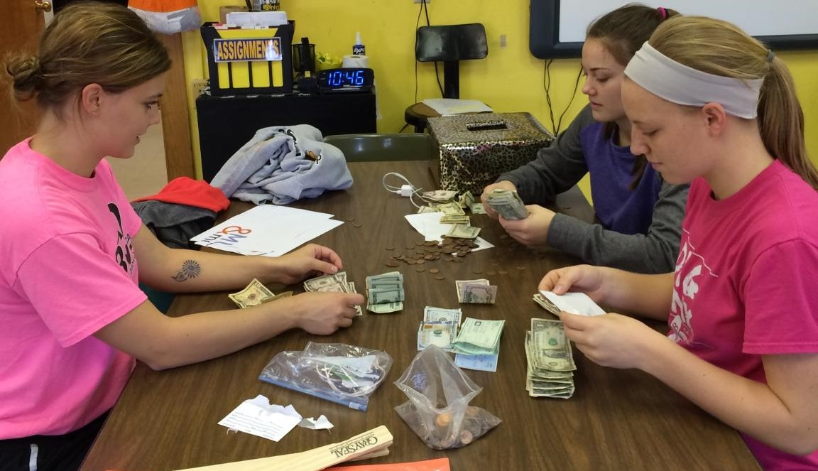
What We Got Was…
Hanna
Maggie
& Kaitlyn
Members of Linn High School Family, Career & Community Leaders of America (FCCLA)

Slide 8
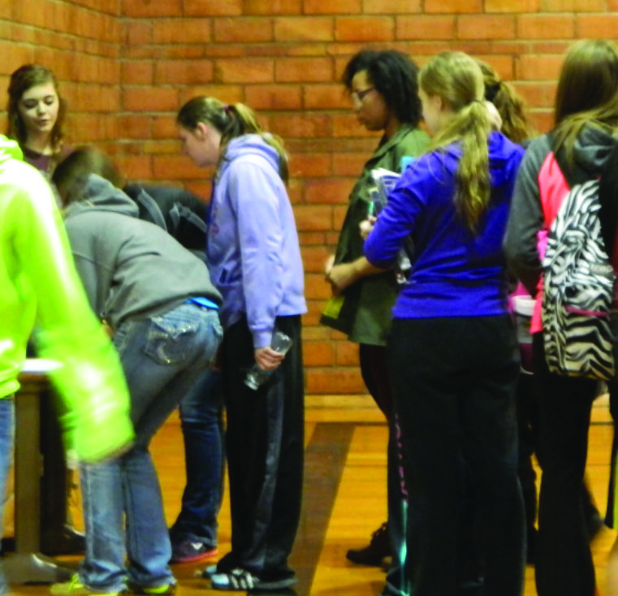
And Then We Got
28 students from student body of 65 lined up to volunteer!
AND coach volunteered the boy’s basketball team!
(Students received 1 hour community service credit for each visit)
We did not lose a single volunteer
Out of 473 total possible visits, the students made 335 between December 1 and April 22 of this school year!

Slide 9
So what did the Hanna, Maggie & Kaitlyn do?
Became our liaison with high school
Researched dementia for themselves
Fundraising
Walk-A-Thon
Applied for a Grant (and won it!)
Labor
All fundraising
Engraved iPods
Setup storage cabinets
Labeled equipment
Arranged a high school presentation about Music & Memory℠, Dementia, and recruit volunteers – 28 signed up from student body population of 65!
Arranged volunteer training sessions
Toured the nursing home themselves with an eye toward “Can we really do this?”
Helped me create a volunteer manual
IPod donation drives
Maintained their high honor roll status, sports leadership and achieved other honors

Slide 10
And gave three presentations about what they had done…

Slide 11
And qualified to present at National Competition in San Diego, CA in July!
(We’re just a little bit proud of them!)

Slide 12
What 28 Student Volunteers Did
Helped me build a personalized playlist for each elder
Listened along
Kept notes
Interacted with the elder
Elders didn’t always want music
Appointments, health, visitors, naps
Sometimes they just wanted company, that’s ok
Other things
Filled mugs with water and ice
Moved stuff
Decorated/undecorated
Played games with elders who weren’t in the program
The 15 basketball boys came over in groups of 5 once weekly
Five students already participated in Music & Memory℠ so we instituted Guy Time. It was a time just for our male residents and the team.
They played games, ate (a big hit!), looked through antique farm equipment magazines and visited. Noodle Ball was a favorite.

Slide 13
What else did LCNH do?
Community Engagement was important to us
We wanted to develop familiarity with the program because we have a dream of bringing it to homebound elders
We want to develop more volunteers
We want to develop donors
Community Engagement is why we developed a Media Plan using our local weekly paper and Facebook
To keep it in front of everyone, make it known
To educate about the lifetime benefits of music and what it does in the brain
(Be sure your media policy/releases are updated for social media, video, photo and voice)
We went with the flow
We didn’t plan for statewide media coverage – radio, television, newspaper and social media - but we used it to make Music & Memory℠ known and help our own community see it was bigger than just us

Slide 14
Helpful hints for starting out

Slide 15
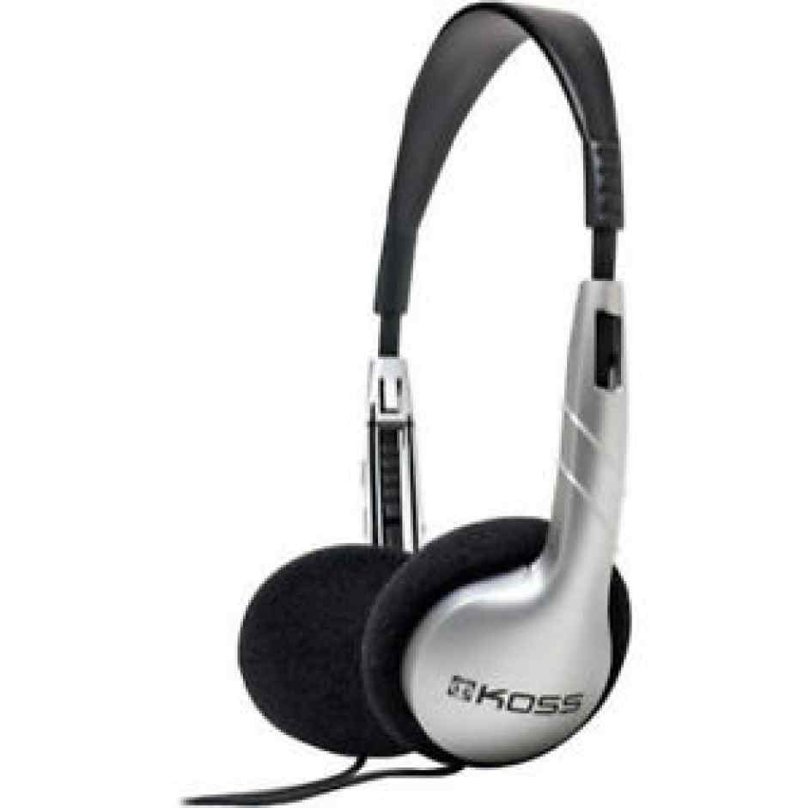
Get familiar with the tools of your trade. Don’t be too proud to ask for help ☺

Slide 16
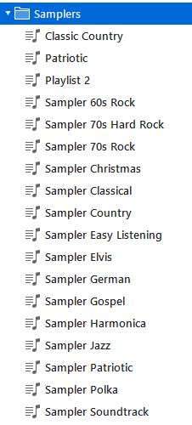
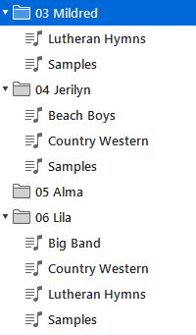
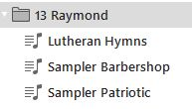
This helped me organize iTunes
How Print a Playlist from iTunes
Highlight the playlist you want to print
Select Ctrl/P at the same time to bring up the dialog box
Select what you want to print from the dialog box
Select what theme you want to use from the dialog box
Print

Slide 17
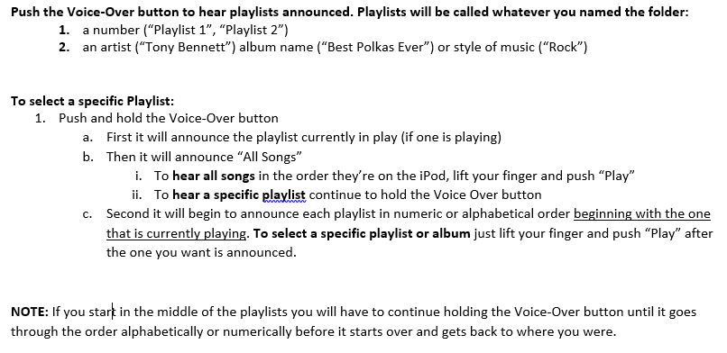
Voiceover Is a Fantastic Tool!
Reminder - it has to be set it up first at the iPod level

Slide 19
Selecting & Purchasing Music
Test music with elders before you buy
Dig into community musical history if applicable
Use in listening sessions with small groups or individuals (free download)
Do they have cds in their room? Ask to borrow them!
Use the genre list from Music & Memory℠ and modify as needed
Use elders’ language - Cowboy, bohemian, WW2 and denominational music
Upload all the nursing home cds for starters
Ask staff and community to “borrow” their Best Of cds
At Christmas ask families for iTunes gift cards. It’s a gift that can’t be lost, misplaced or stolen; the elder can share with others; and it gives forever!

Slide 20
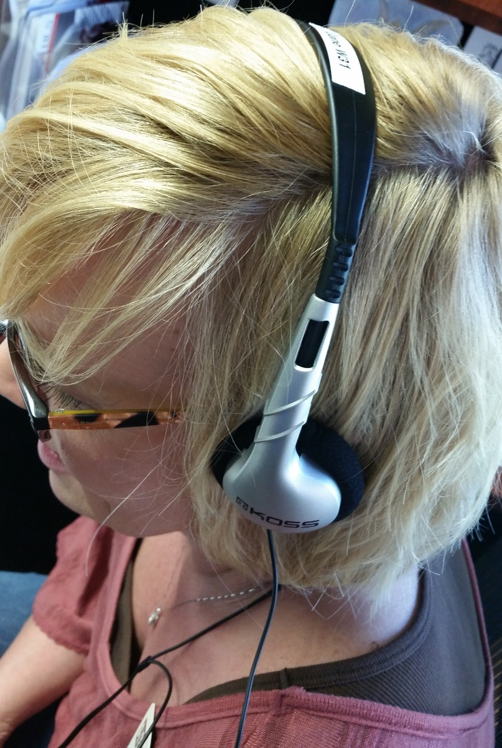
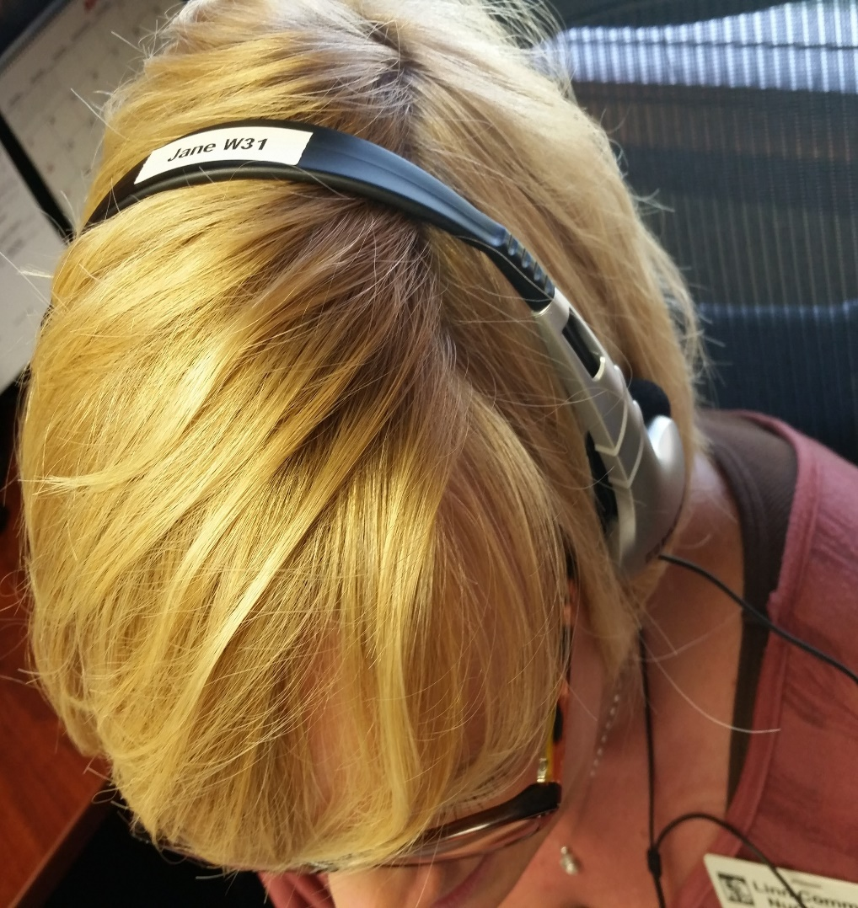
Headphones
Earmuffs – not earbuds!
Label so you can read elder’s name when they’re on correctly (bulk of the headphone goes toward the back of head)
ALWAYS place on yourself first and do a volume check
Explain what you’re doing when you put them on
We’ve had no issues with refusal
The best way to block out other noise and focus, especially with dementia residents

Slide 21
Music & Memory ℠ has what you need to succeed!
YOU CAN DO THIS!
The Music & Memory℠ Care Community site has everything you need to get started and learn best practices. This is brand new and in response to the explosive growth of Music & Memory℠!

Slide 22
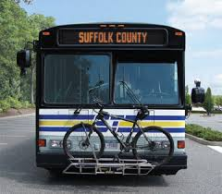
Lessons Learned as a Coordinator
Create a Bus Book as you go (or at least keep computer notes)
because…you never know! Someone will need the information
you have in your head when you’re not there to share it.
Don’t prejudge musical tastes - our 75 year old LOVES the Rolling Stones
Start with a new computer if at all possible and use it only for M&M
A good wifi connection is a must when downloading music
iPod Shuffles have the smallest learning curve for everyone involved
It’s quality, not quantity, when it comes to your iTunes account
Get rid of cds so all staff becomes familiar with iPods. Get Activities an iPod with speaker. Donate your CDs to another facility that’s just getting started!

Slide 23
Linn Community Nursing Home
612 Third Street Linn, KS 66953
785-348-5551
Online - www.LinnComm.org On Facebook - Linn Community Nursing Home
Martha Hornbostel, Music & Memory℠ Coordinator
LCNHMusic@gmail.com
Janell Wohler, Administrator
785-348-5551 - Admin@LinnComm.org

