Slide 1
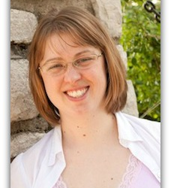
Music! Music! Music! in Senior Living
Rachelle Norman, MA, MT-BC
Soundscaping Source, LLC

Slide 3
Academic Background
Bachelor of Music in Music Therapy – University of Evansville – Evansville, IN
Clinical internship – MusicWorx of California – San Diego
Master of Arts in Music Therapy – Saint Mary-of-the-Woods College – distance learning – 2007-2010
Adjunct Faculty – Saint Mary-of-the-Woods College – music therapy equivalency distance program – 2012-present

Slide 4
Professional Background
Soundscape Music Therapy – Newton, KS – 2004-2008
Soundscape Music Therapy – Kansas City area – 2008-present
Presentations/Courses Taught:
Local, regional, national music therapy conferences
Eldercare professional groups
Soundscaping Source webinar series
Relias Learning course
LeadingAge Kansas webinar
National Center for Creative Aging conference

Slide 5
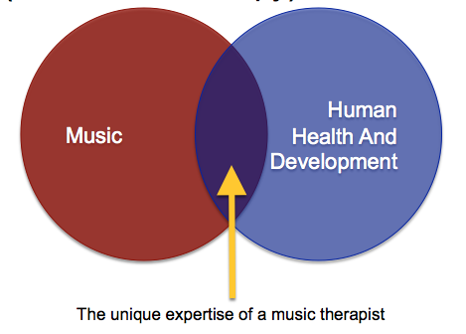
Expertise on Music in Healthcare

Slide 6
What is music therapy?
Clinical process guided by a credentialed music therapist
Therapy happens during musical interactions in a therapeutic relationship
Examples of music therapy sessions
Music therapy is just one small part of what music therapists have to offer
Examples of integrating music with overall care plan

Slide 7
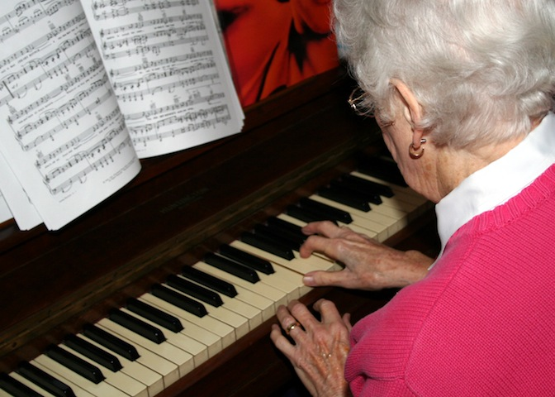
In my ideal world…
Why???

Slide 8
Why music?
Brain, background, and being together
Brain
Limbic system
Feel good neurotransmitters
Movement
Background
Culture
Personal history
Memories
Being together
Relationships
Music is what we do together

Slide 9
Benefits for Residents AND Caregivers
Strengthens caregiving relationship
Makes routine caregiving tasks easier
Changes the feeling of your community

Slide 10
Benefits for Residents AND Caregivers
Strengthens caregiving relationship
Try this: Take 5
Makes routine caregiving tasks easier
Try this: Sing your residents to supper
Changes the feeling of your community
Try this: Experiment with music listening stations in various places at various times of day

Slide 11
Tips For Selecting Music:
Emphasize personalized/biographical music
Don’t forget to ask family members
Know that some songs may be upsetting when listening alone
Try small group listening sessions to test out songs that residents might enjoy
Use volunteers to run music listening sessions
Feel free to add and subtract music from playlists as needed

Slide 12
More Tips:
Recognize caregivers who are involving residents in music
Emphasize relationships over solo listening
Watch for over-stimulation
Make sure the music is actually playing ☺

Slide 13
Get more help!
Sign up for Soundscaping Source newsletters (free!)
http://soundscapingsource.com/goodstuff
Attend the LeadingAge Kansas webinar on June 23 – How to Make Caregiving Tasks Easier with Music
Get a free 30-minute strategy session (limit 5)
http://soundscapingsource.com/strategy

