Slide 1
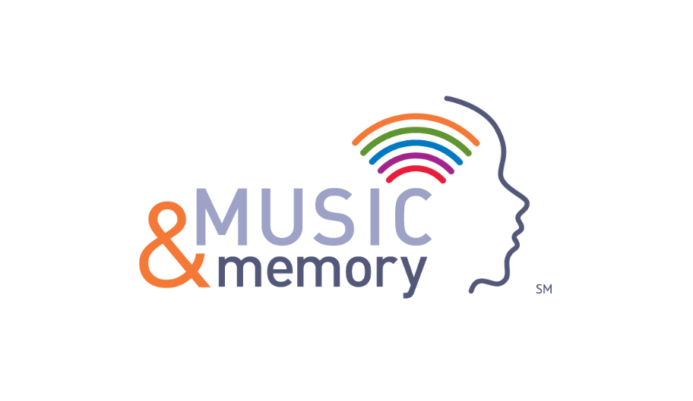
Matt Nutter, CTRS
Presentation by:
Pinnacle Ridge Nursing and Rehabilitation

Slide 2
MUSIC AND MEMORYSM Takes a Team

Slide 3
TEAM RESPONSIBILITIES
1. Identify residents who staff believes would benefit from personalized music
2. Meet with resident/family to discuss music preference and conduct music assessment
3. In consultation with interdisciplinary team incorporate in care-plans

Slide 4
TEAM RESPONSIBILITIES
4. Develop, download and update play list to MP3
5. Deliver MP3 Player to resident and assist in set up as needed
6. Collect MP3 Player from resident when session is over and stores in designated location
7. Review resident satisfaction with the play list as needed.

Slide 5
BENEFITS & successes

Slide 6
ANTICIPATED BENEFITS
Reduce their reliance on
Anti-psychotic medications
Anti-anxiety medications
Reduced agitation and sun downing

Slide 7
ANTICIPATED BENEFITS
Enhanced engagement and socialization
Increased cooperation and attention
Reduce resistance to care

Slide 8
SUCCESS
Have seen reduced agitation upon implementation of music.
Therapy department able to provide effective treatment

Slide 9
Obstacles

Slide 10
OBSTACLE 1: CULTURE CHANGE
Family Members
Resident
ALL Staff Members
Benefits
Unified care partner team members MUST cooperate in long term process of culture change for benefits to occur.

Slide 11
OBSTACLE 2: HEADPHONES
Some residents will be less receptive to a strange new item over their ears producing sound
Days to weeks of one on one training for comfort

Slide 12
OBSTACLE 3: CONSISTENT USAGE & CHARGING
Multiple feedback forms attempted
Organization of necessary tools
Ease of access
MP3 count each night

Slide 13
Contact Information
Matt Nutter, CTRS
-Recreational Therapist
-Pinnacle Ridge Nursing and Rehabilitation
-Email: matthew.nutter@pcitexas.net
-Work Phone: (913) 782-3350
-Fax: (913) 782-1732

