Slide 1
Kansas Music & Memory Project
Getting Started- Tips and Suggestions from current M&M providers
March 22, 2016

Slide 2
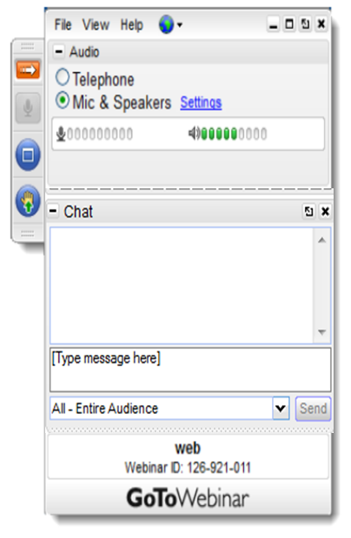
Use the Red Arrow to expand or collapse your control panel.
Audio: Select Mic & Speakers to use your speakers for audio or call-in using your phone. Choose the telephone option to see the call-in information.
Mute: All lines are muted.
Questions: Enter questions in the chat box and We will respond during the Q&A following the presentation or click the hand icon and we will unmute your line.
Recording: These webinars is being recorded and one will be available on our website.

Slide 3
Today’s Webinar
Kansas Music & Memory Project – Barbara Hickert, SLTCO
Linn Community Nursing Home – Martha Hornbostel, M&M Coordinator
Pinnacle Ridge Nursing and Rehab – Matthew Nutter, CTRS
Opportunity for you to ask questions
Stephanie Hoffman, Regional Director, Music & Memory

Slide 4
Update on Project
Certification training
Starter Kits delivery
Ongoing support
From Ombudsman office
Monthly Webinar’s
Regional support
From Music & Memory
Care Community Website
Support Calls
Topic Calls

Slide 5
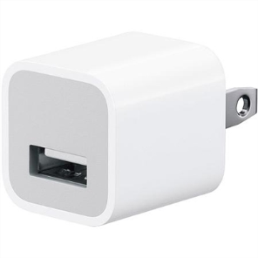
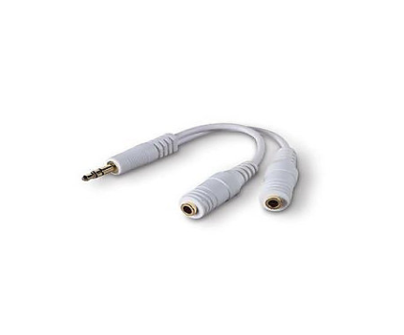
Great News - Starter Kits
7 iPod Shuffles – varies colors
7 Koss headphones
7 AC adaptors
1 splitter - 5
1-$25 dollar iTunes gift card - $50

Slide 6
Questions about the Project
Barbara Hickert
State Long-Term Care Ombudsman
1-877-662-8362
Barbara.hickert@ks.gov
Website Music & Memory Project
http://ombudsman.ks.gov/resources/music-memory
Webpage for locating your regional ombudsman
http://ombudsman.ks.gov/contact-the-office
Music & Memory’s website
http://musicandmemory.org/
Notes:
The primary responsibility of the LTCOP is to serve as the resident advocate. LTCO support resident-centered care and residents guide all LTCO work.

Slide 7
Kansas Long-Term Care Ombudsman Program
900 SW Jackson
Topeka, Kansas 66612
785.296.3017
877.662.8362
LTCO@ks.gov
http://Ombudsman.ks.gov

